Slide 1
Scholarships: Exploring other options for UTECH Graduates
Presenter: Dianne Plummer
September 11, 2014

Slide 2
Objectives
Masters/ PhD
Erasmus Mundus
Entrepreneurship

Slide 3
Erasmus Mundus
Scholarships are out there: up to you to find them and apply
Set personal timeline targets
Erasmus Mundus Joint Programmes:
Follow an integrated Masters Course or Doctoral programme in two or more universities
All students from Jamaica are eligible to apply for scholarships to 138 Erasmus Mundus Joint Masters and 42 Erasmus Mundus Joint Doctorates.
Programme site: http://eacea.ec.europa.eu/erasmus_mundus/index_en.php

Slide 4
The SELECT Programme
"SELECT master programme (Environomical Pathways for Sustainable Energy Systems) aims to attract top performing students from around the world and to deliver the right type of engineering graduates to advance leadership, industrial practice, innovative solutions and entrepreneurship”

Slide 5
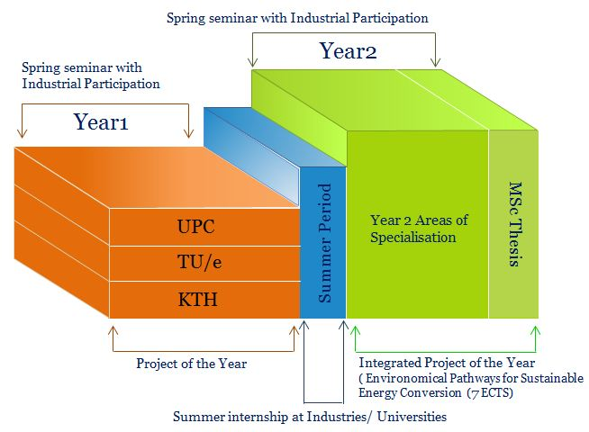
SELECT Program

Slide 6
Partner Universities
KTH Royal Institute of Technology (KTH), Sweden
Politecnico di Torino (PoliTo), Italy
Technical University of Catalonia (UPC), Spain
Aalto University School of Science and Technology (Aalto), Finland
AGH University of Science and Technology (AGH), Poland
Instituto Superior Técnico (IST), Portugal

Slide 7
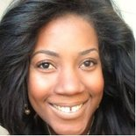
Erasmus Mundus Student: Dianne Plummer
Dianne was awarded Scholarship in 2011 to pursue a Master’s in Environomical Pathways for Sustainable Energy Systems.
Recipient of Innoenergy Scholarship in 2011
Studied at prestigious universities in Sweden, Finland and Spain
Currently Lecturing at UTECH Jamaica
She gives Erasmus Mundus Five Stars
Programme website: http://www.exploreselect.eu/Home/tabid/523/language/en-GB/Default.aspx

Slide 8
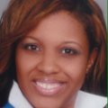
Erasmus Mundus Student: Terica Sinclair
Terica Sinclair was awarded a scholarship to pursue a Masters Degree in Membrane Engineering in 2011.
She studied at prestigious universities in France, Czech Rep and Spain.
She moved directly in to PhD after receiving another Erasmus Mundus Scholarship to study Advanced Membrane Engineering.
She gives Erasmus Mundus Five Stars

Slide 9
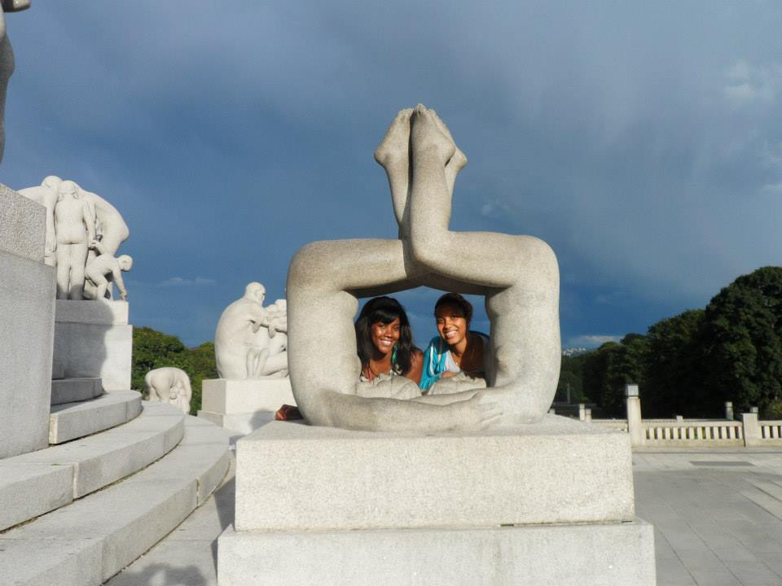
Apply, study and have fun!
Visited most of the countries in Europe. Via the program and personal travels. We were able to learn languages, appreciate different cultures, people and cuisine.
Apply, study and have fun!

Slide 10
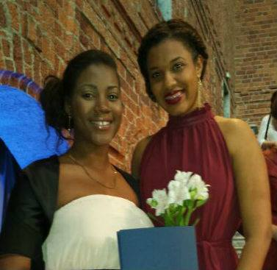
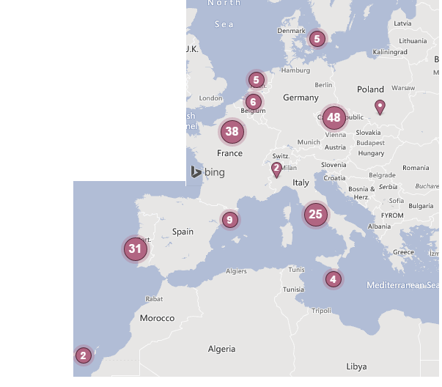
Apply, study and have fun!

Slide 11
Entrepreneurship
How many of you want your own company?
JBDC : Jamaica Business Development Corporation
Branson Center of the Caribbean
PSOJ: Private Sector Organisation of Jamaica
JN Foundation
Digicel Foundation
SRC : Scientific Research Council
TIC : Technology Innovation Center
Start Up Jamaica

